Slide 1
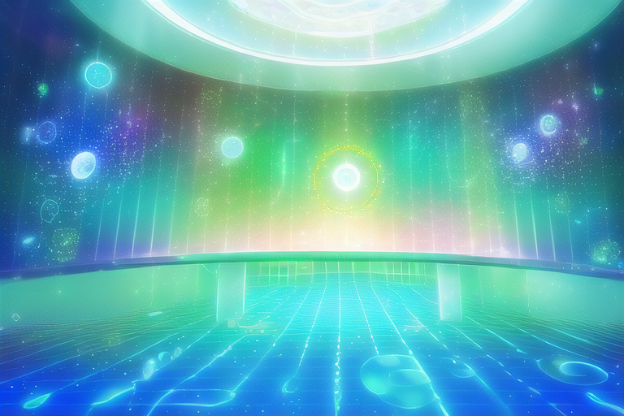
Ocular Disease Detection
Author & Presenter: David Bui

Slide 2


Mission Statement
The primary goal of this project is to successfully train a machine learning algorithm that can differentiate between multiple classifications of diseases that cause visual impairment. The classifications that are most important are for early detection, since most visual impairments are preventable today, and early detection can be rather difficult find for many practitioners.

Slide 3
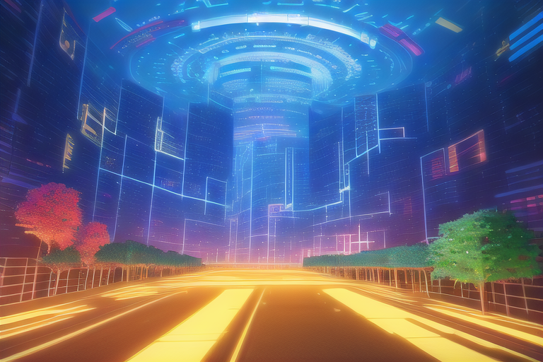
Understanding the Problem and a potential solution
There are currently 43 million people that are completely blind and 295 million people that suffer from moderate to severe visual impairments, and out of this group 77% of these cases are completely preventable.
90% of these cases of blindness occur in developing 3rd world countries where there is limited access to medical care.
The application of building an AI that can detect these early stages of disease would allow volunteers the ability to treat mass amounts of people, with relatively cheap cost.
This information was pulled from the World Health Organization.

Slide 4

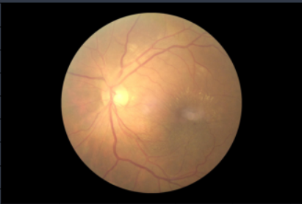
Understanding the data
Internal
Kaggle Dataset: https://www.kaggle.com/datasets/andrewmvd/ocular-disease-recognition-odir5k
Consists of 8,000 fundus images of 4,000 patients.
8 Classifications:
Normal, Abnormal, Cataract
Glaucoma, Myopia
Age-Related Macular Degeneration
Hypertension, and Diabetic
Filename: 521_left.jpg
521 is the patient’s unique identifier.
Each patient has a left and right eye image.

Slide 5
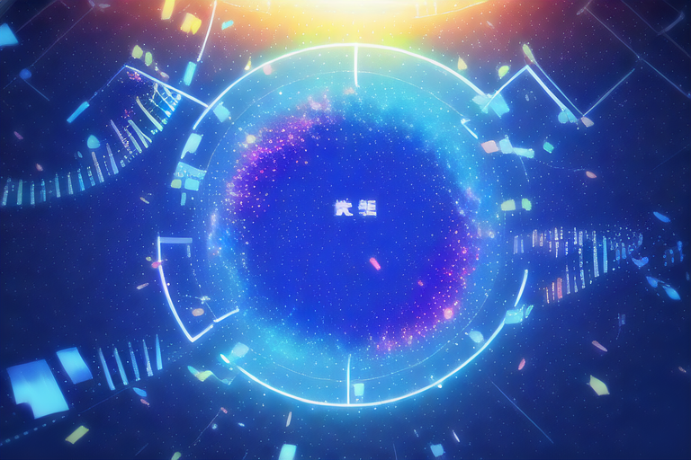
Challenges
One the biggest challenges within this project is that the dataset contains images that hold multiple classifications, which means a image can hold multiple diseases. This brings a great deal of change in the requirements of the algorithmic model.
Images require preprocessing and standardization before being fed into the model.
The implementation of a web-based application can be difficult for this project in terms of testing.
The deep learning models must be simplified in order to fit the Streamlit platform.
Security is complicated since user must be given access to the trained models, which is not the ideal scenario.

Slide 6

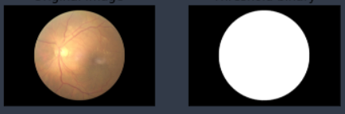
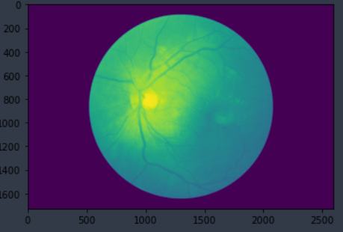
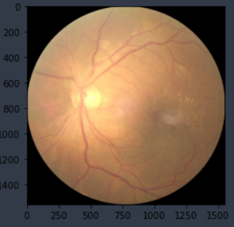
Data Pipeline
Each image is trimmed and standardized to a specific size of resolution.
Images are viewed in a negative format to provide additional perspective.

Slide 7

Possible Models for Classification
Object Detection and Segmentation
Convolutional Neural Network (CNN)
Mask R-CNN
Faster R-CNN
You Only Look Once (YOLO)
Single Shot Multibox Detector (SSD)
RetinaNet
CenterNet
Deep Residual Networks (ResNet)
Region-Based Fully Convolutional Network (R-FCN)

Slide 8

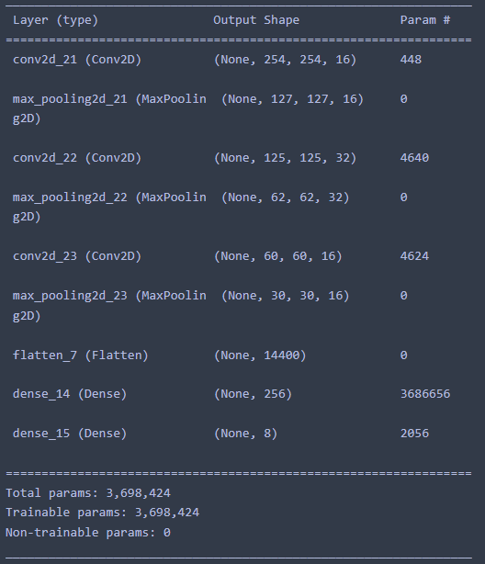

Design Architecture
The Ensemble employs 3 Convolutional Neural Networks with 3 layers of pooling before being flattened out and condensed for a final output. The activation function within this network is Relu.

Slide 9
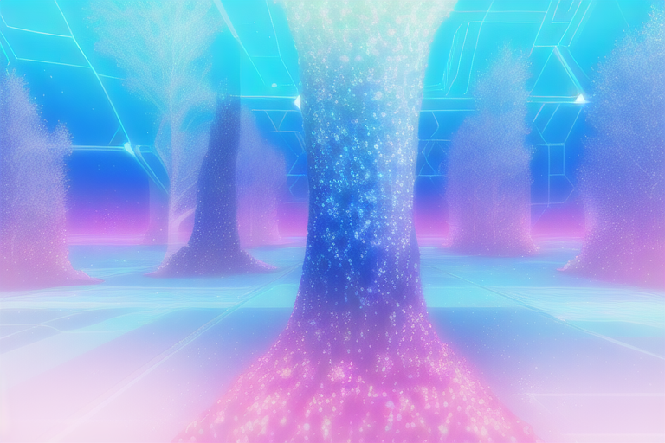
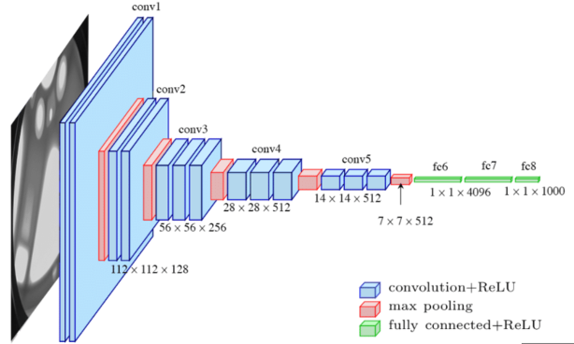
Convolutional Neural Network ensemble
The convolutional neural network (CNN) is a type of deep learning model that is commonly used for image classification tasks.
The CNN has been trained on a dataset of 8000 images that have been resized to 128x128 pixels.
The dataset likely includes multiple classes of ocular diseases as well as normal images.
The CNN architecture likely includes multiple layers of convolutional, pooling, and fully connected layers that are designed to extract features from the input images and make predictions about their class labels.
During training, the CNN adjusts the weights of the model to minimize the difference between its predicted class labels and the true labels in the training dataset.
The training process involves multiple iterations or epochs, during which the CNN makes predictions on the training data, compares them to the true labels, and adjusts its weights accordingly.
After training is complete, the CNN can be evaluated on a separate test dataset to measure its performance on new, unseen images.
The accuracy of the CNN's predictions on the test dataset can be used to assess its ability to accurately classify ocular diseases based on the input image features.
The chosen model is a CNN, which is infamous for its usage of analyzing digital imaging.

Slide 10

System Requirements
CPU: Intel i5 or higher
GPU: Nvidia GeForce RTX 3060 or GPU with tensor cores
RAM: 16 GB or more
Hard Drive: 100 GB or more
Software requirements:
Operating System: Windows 10 or Ubuntu 20.04 LTS
Python 3.8 or higher
Tensorflow 2.0 or higher
Streamlit 0.80 or higher
Jupyter Notebook or any other code editor
Note: The above requirements are just recommendations. The system requirements may vary depending on the size of the dataset and the complexity of the CNN model being used. It is always recommended to have the latest versions of software installed on your system to ensure optimal performance.

Slide 11

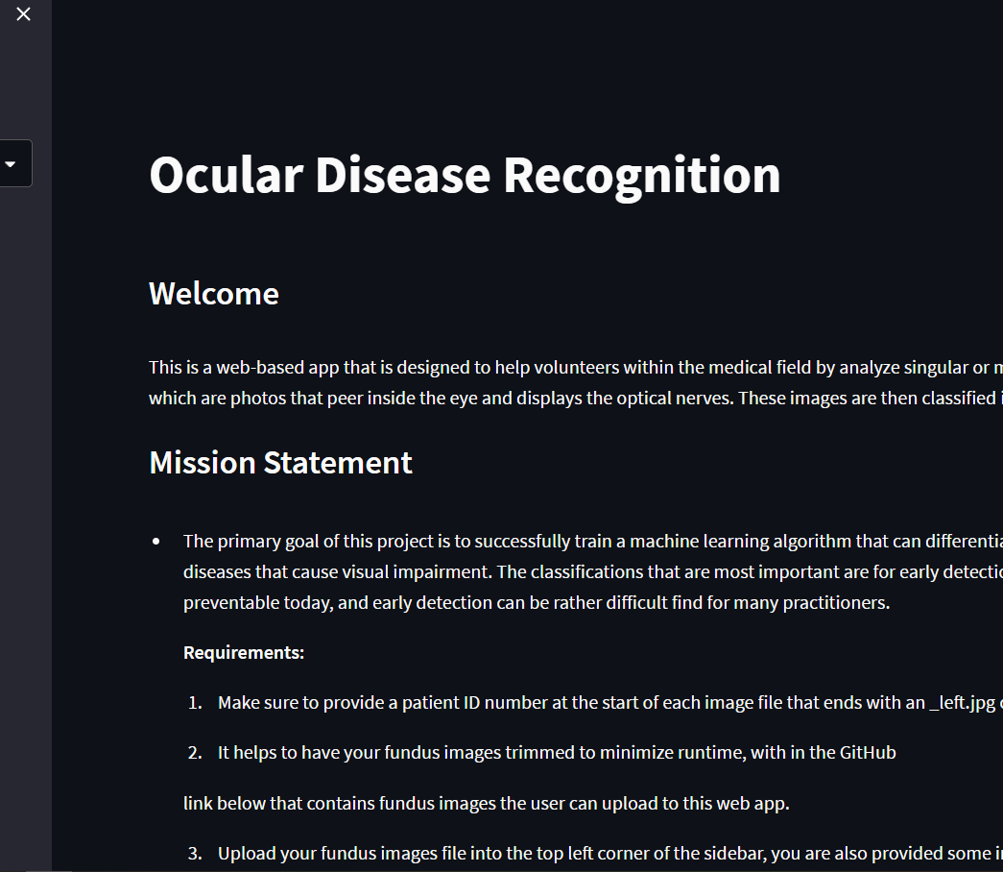
Implementation
Streamlit is the package tool used to build a web-based application.

Slide 12

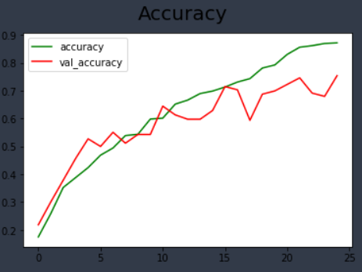
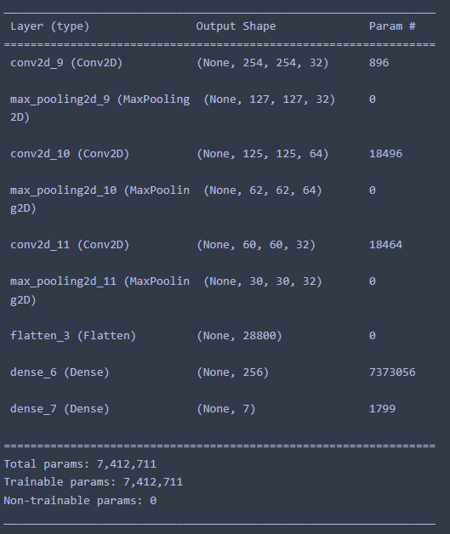
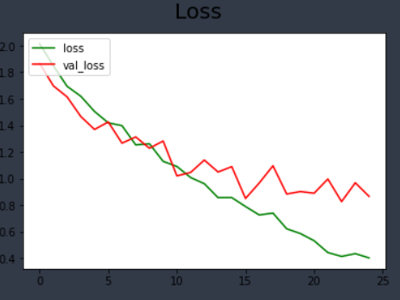
Testing
The testing with through 7,400,000 parameters in training with 20 epochs.
Accuracy still has room for improvement.
Within the Loss chart there is evidence of some overfitting taking place.

Slide 13

Improvements
A potential improvement for security can be made by holding the model on a secure private server, while also providing an avenue for collecting user data for improving the model.
Additional models can be used for comparison outside of the given ones.
The data can be verified by a practitioner.
Allowing for multiple classifications for each image.
Further examination of the tuning of the parameters of each tested network.
Use a Linux operating system to train the model for faster runtimes and gpu acceleration,

Slide 14

References
https://www.who.int/news/item/09-10-2003-up-to-45-million-blind-people-globally---and-growing

Slide 15

Christian worldview as a data Scientist

